Slide 1
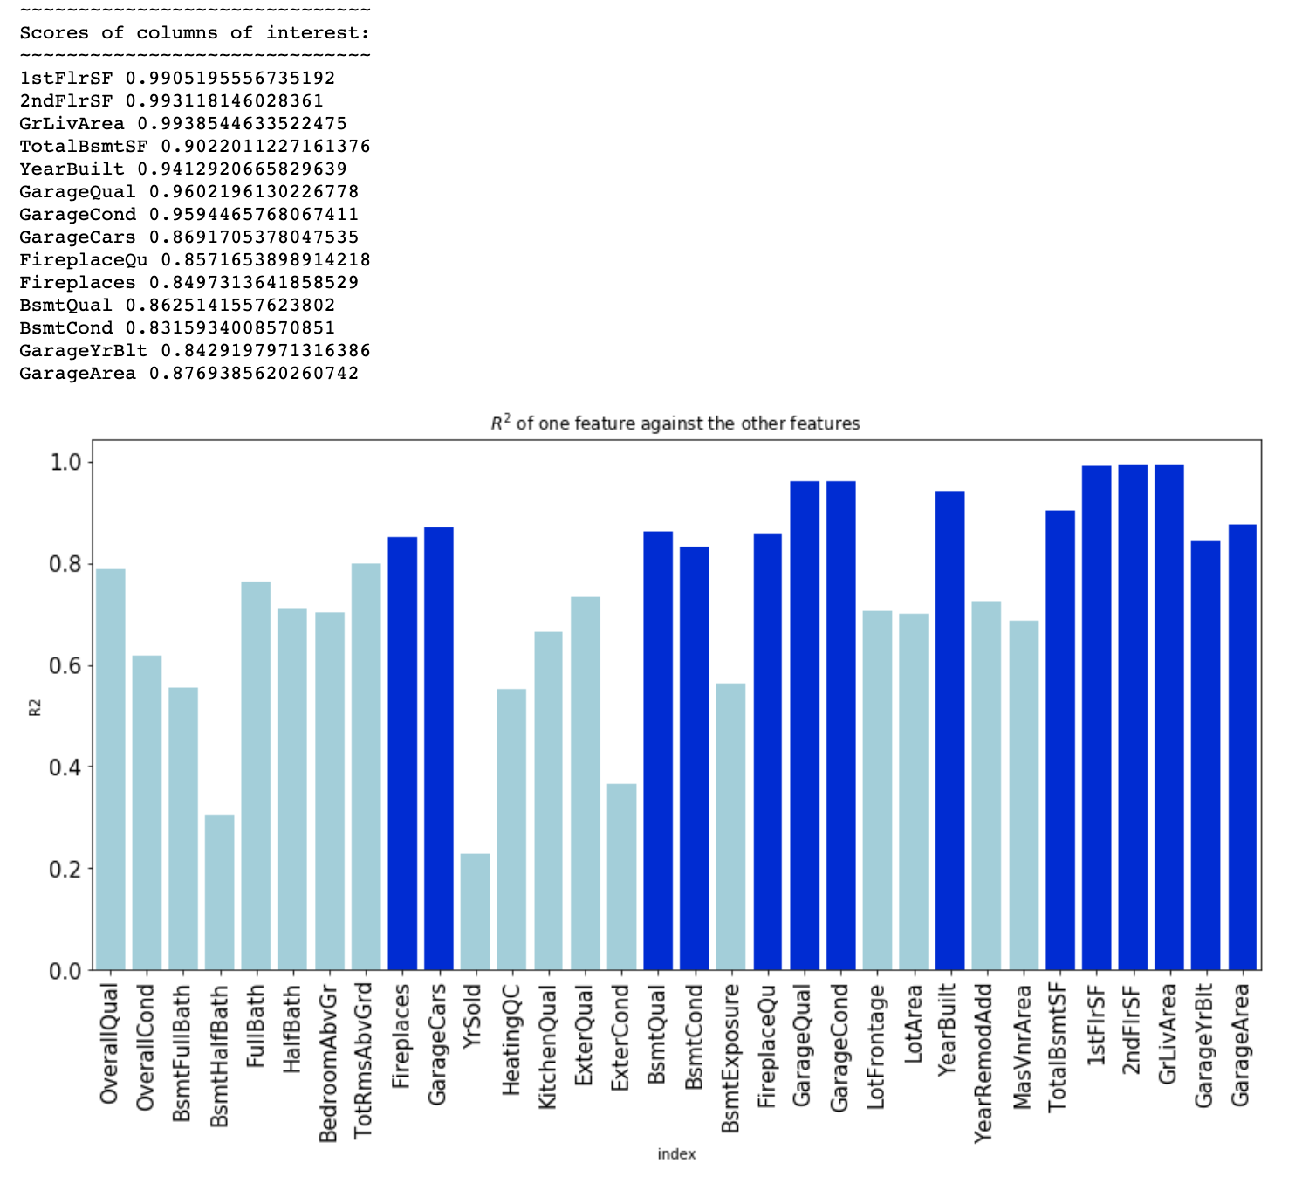
Variables R2 > 0.8 highlighted

Slide 2
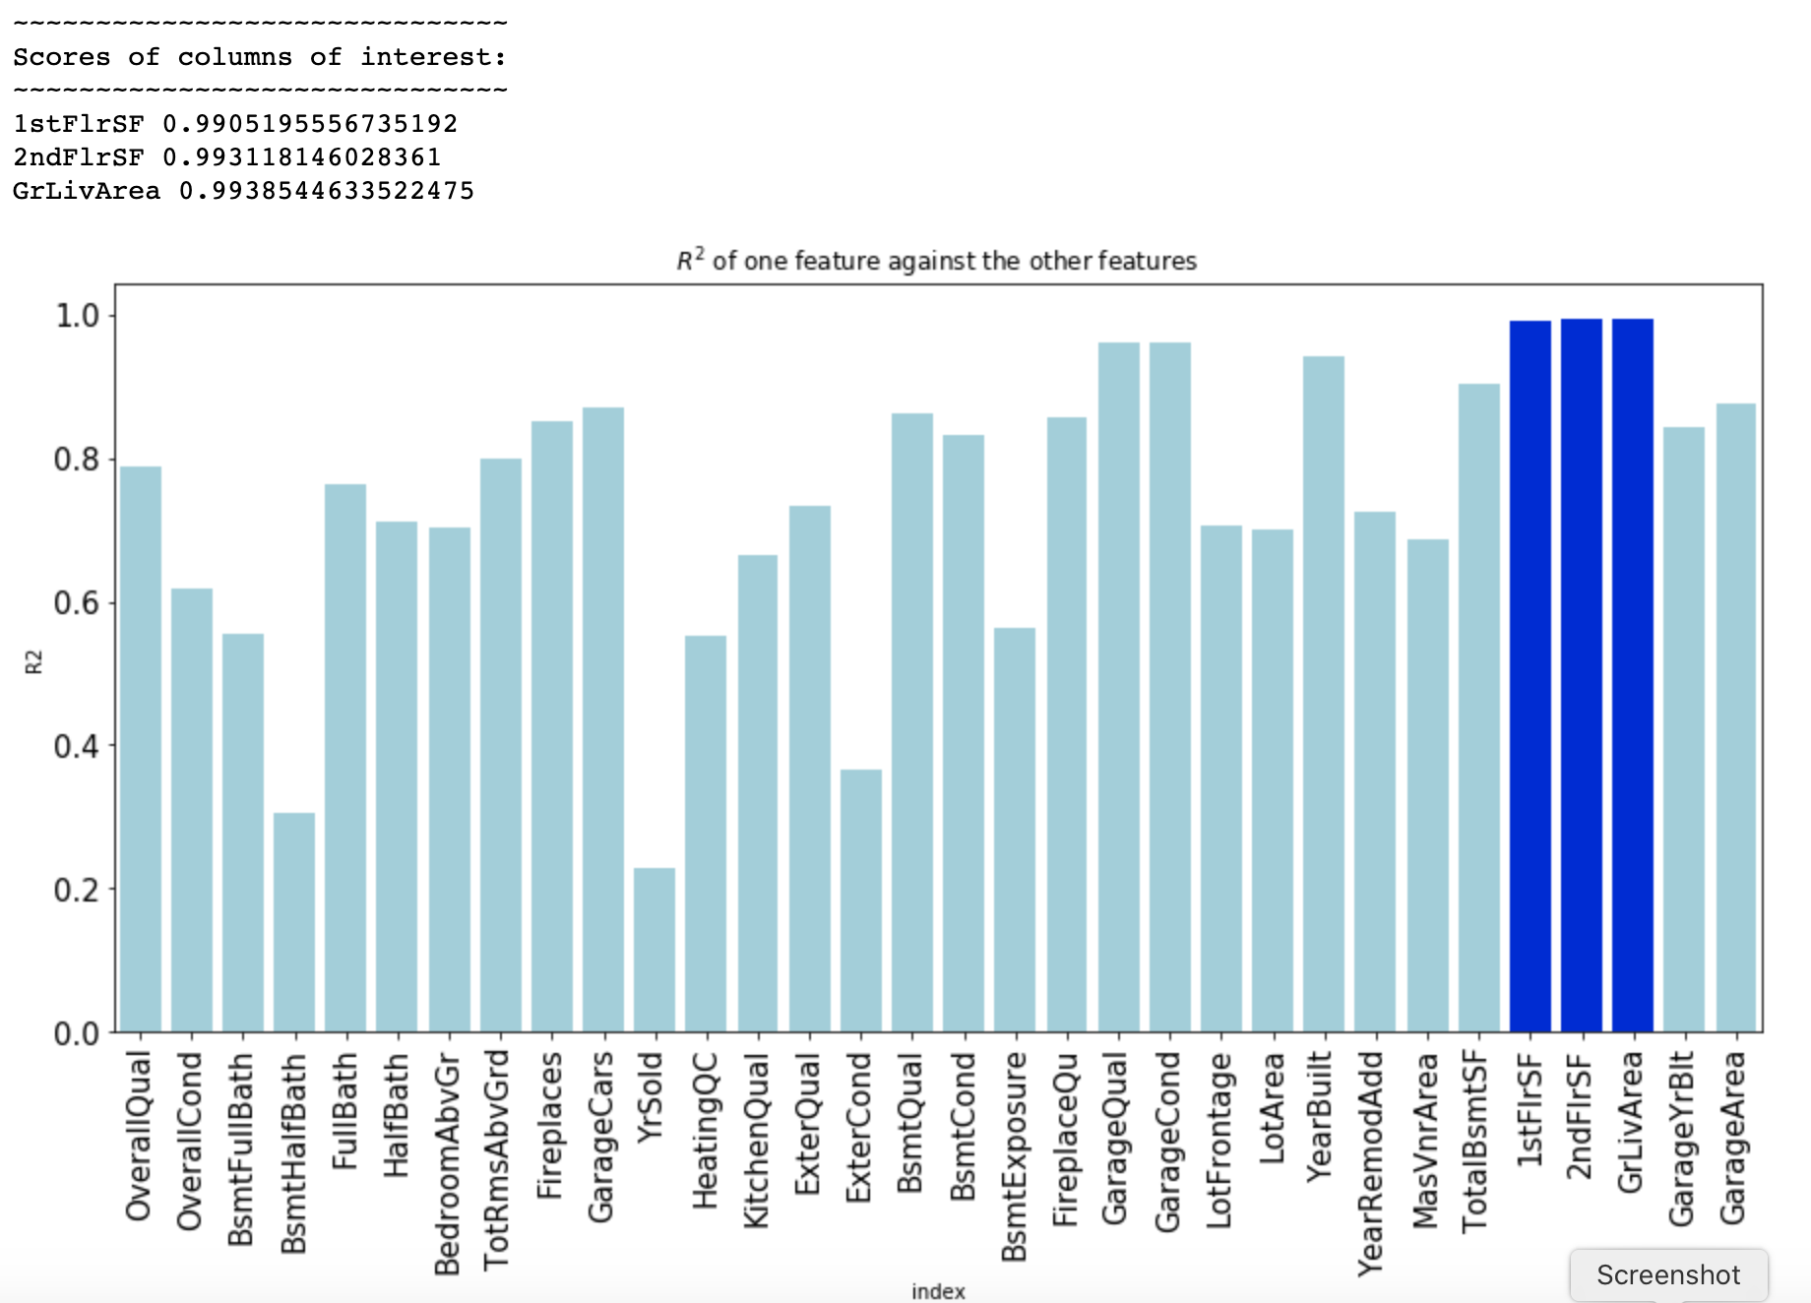
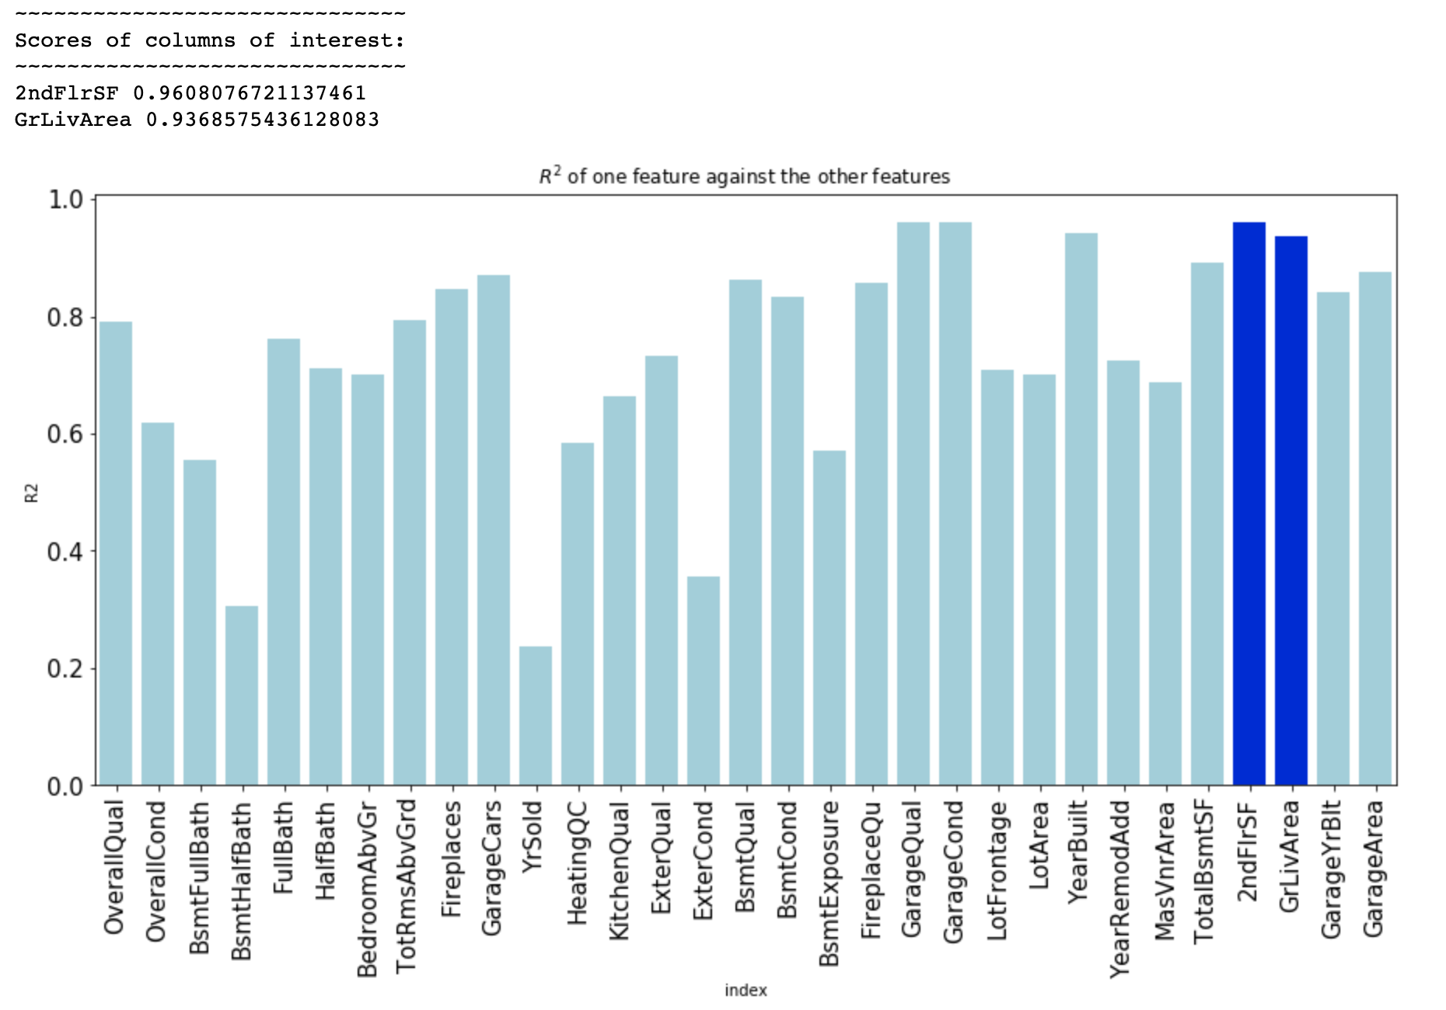
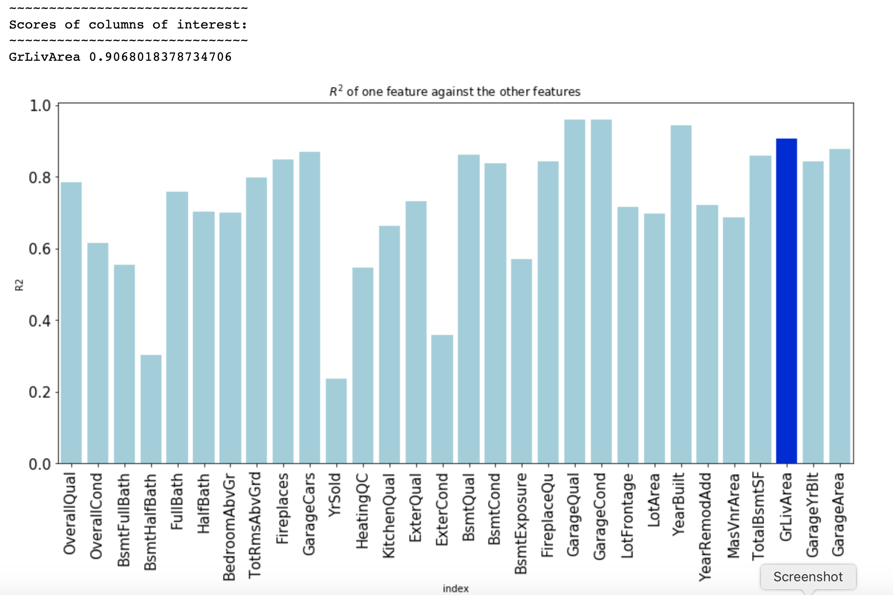
Trial 1 - 1st floor removed
Trial 2 – 2nd floor removed
R2 of GrLivArea reduced in VIF with trial1 and trail2 columns dropped

Slide 3
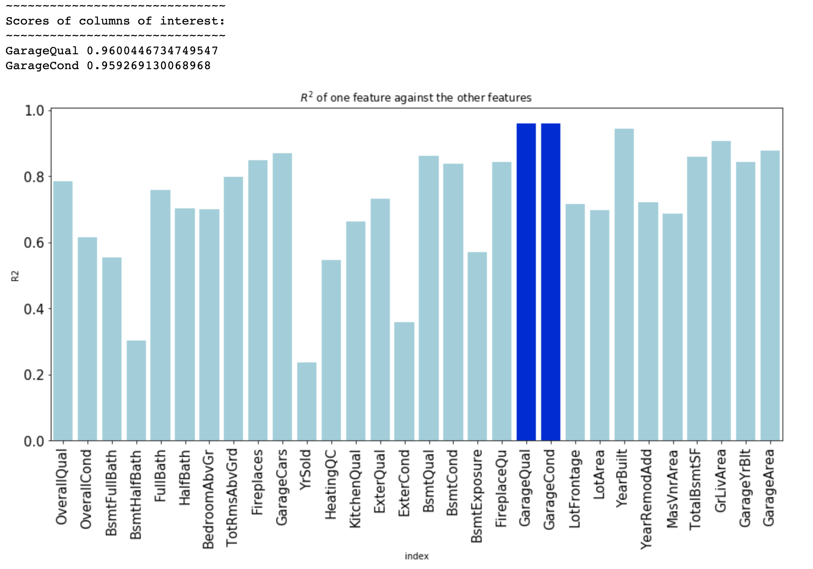
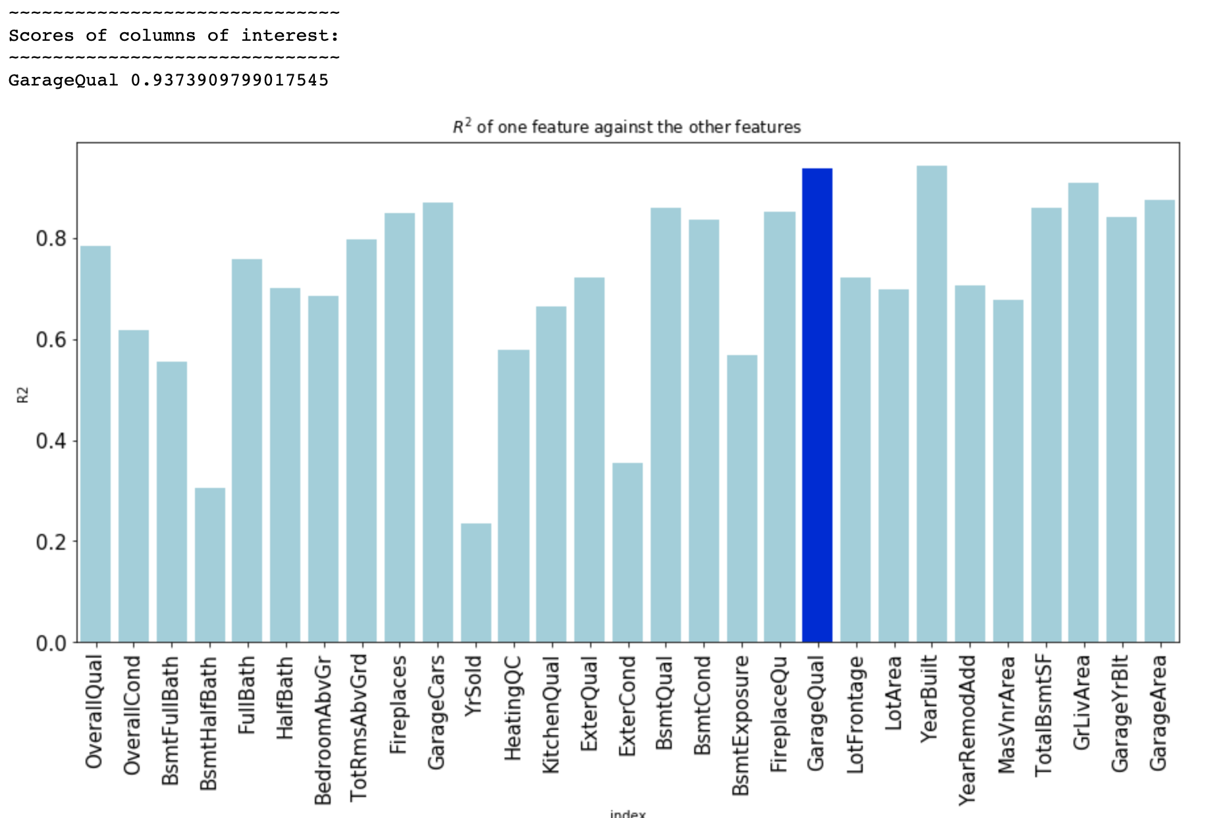
GarageQual and GarageCond assessed
GarageCond removed
R2 of GarageQual reduces

Slide 4
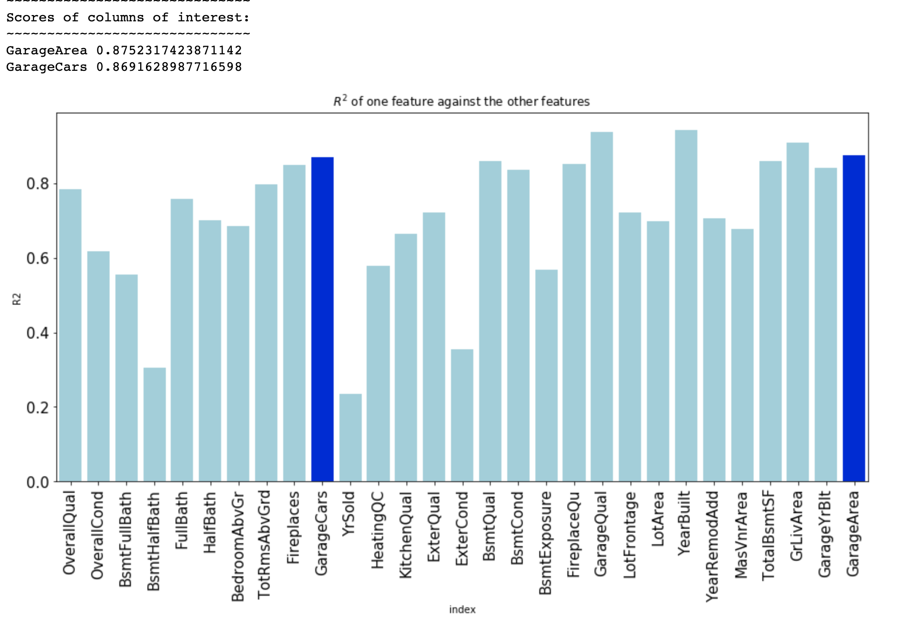
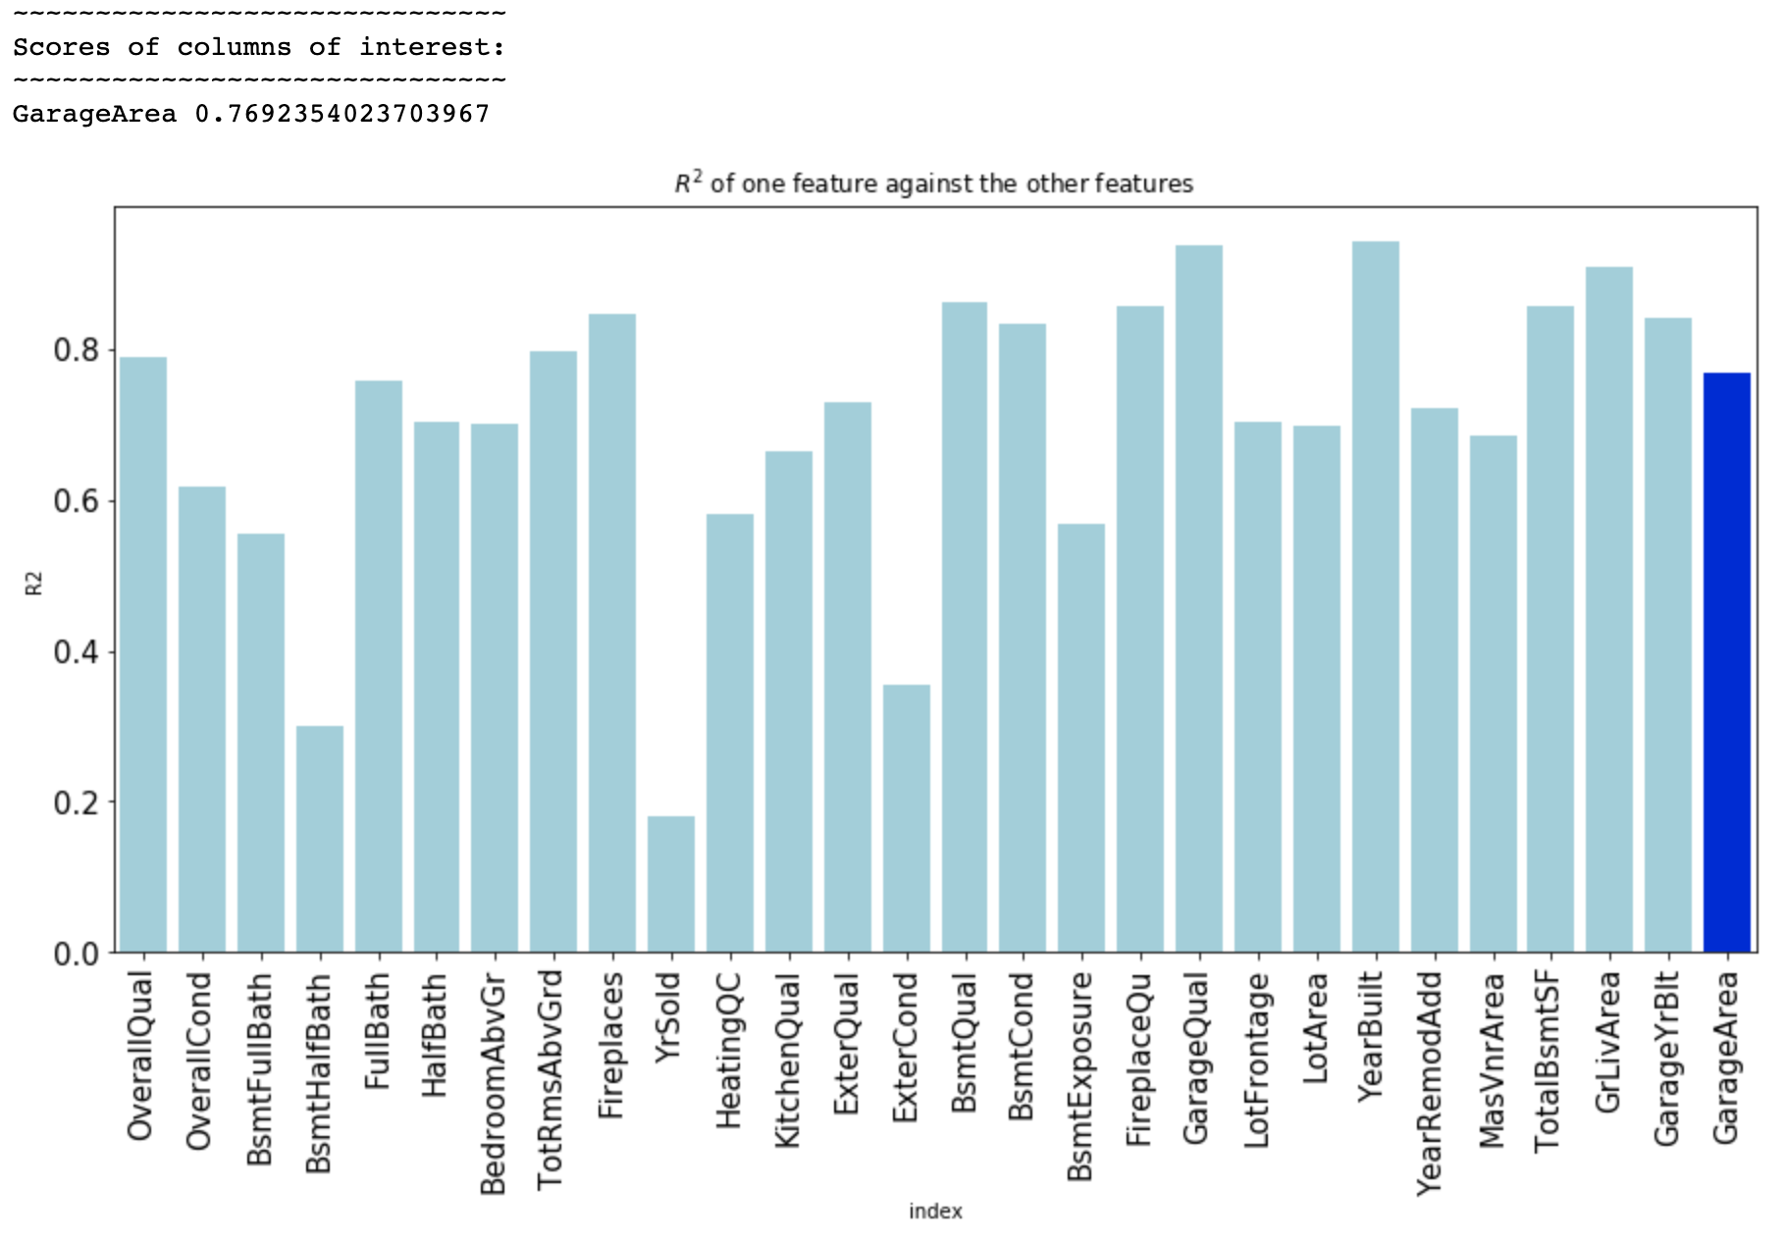
GarageArea and GarageCars assessed
GarageCars removed
R2 of GarageArea reduces

Slide 5
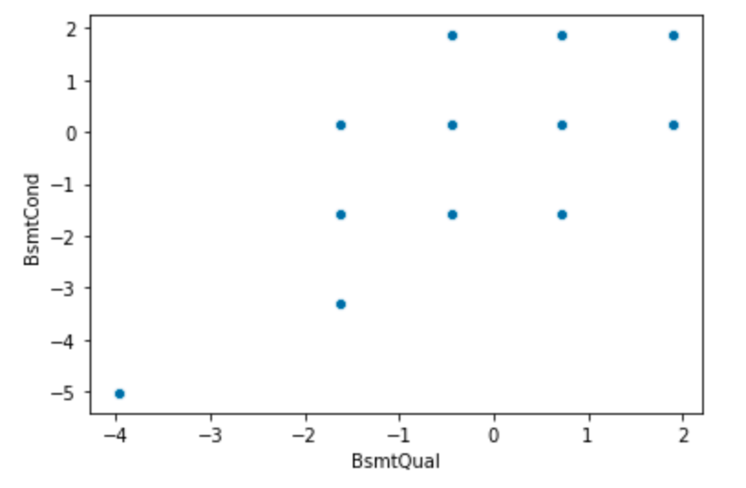
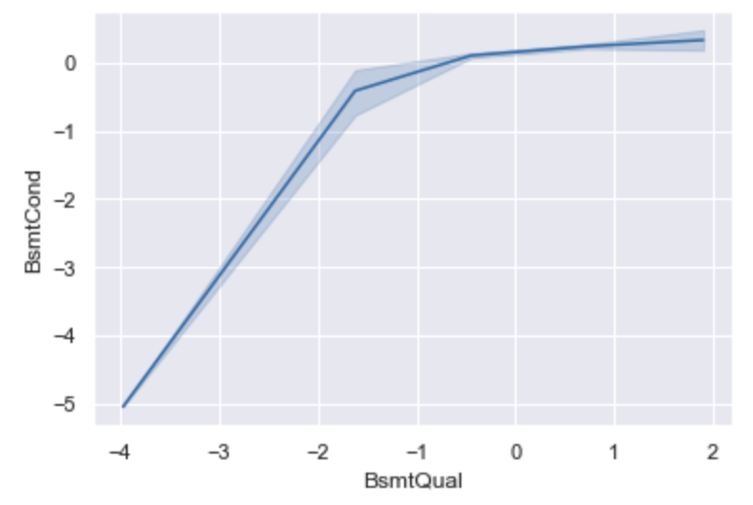
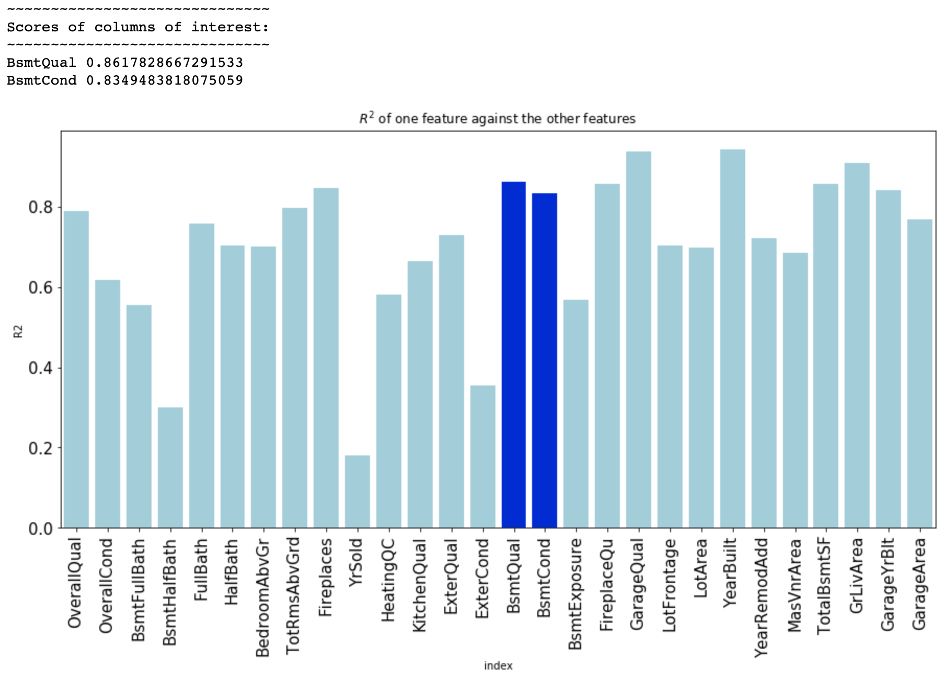
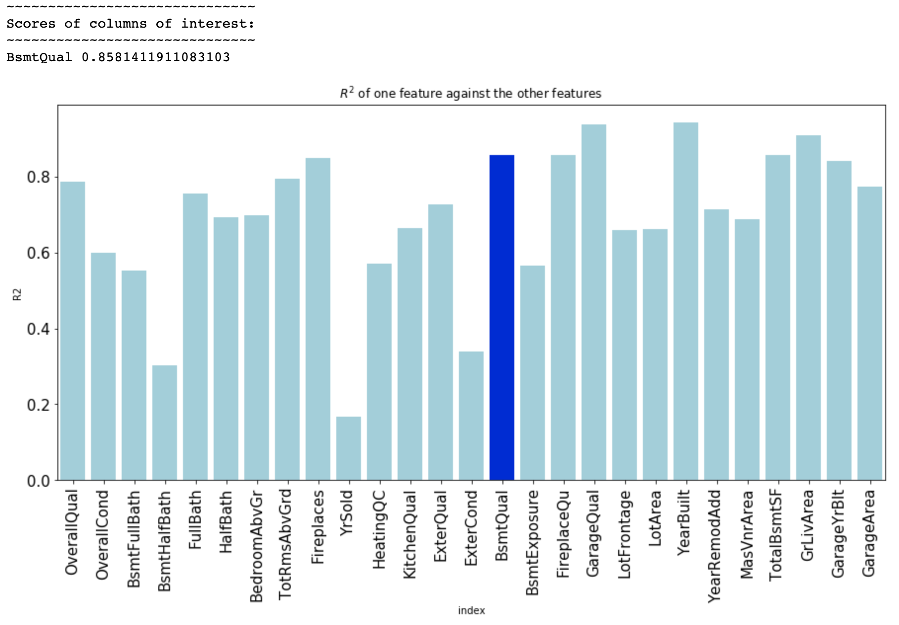
Plots to check if BsmtCond and BsmtQual are directly proportional
BsmtCond and BsmtQual assessed
BsmtCond removed
R2 of BsmtQual reduces

Slide 6
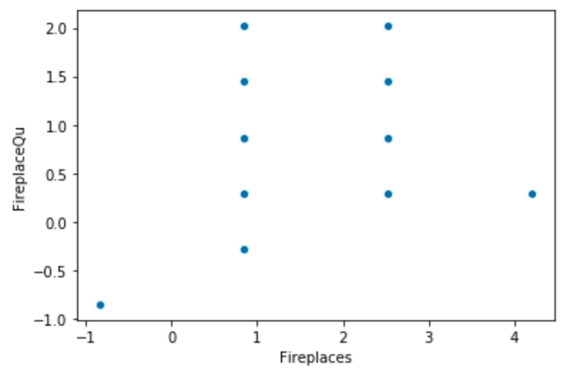
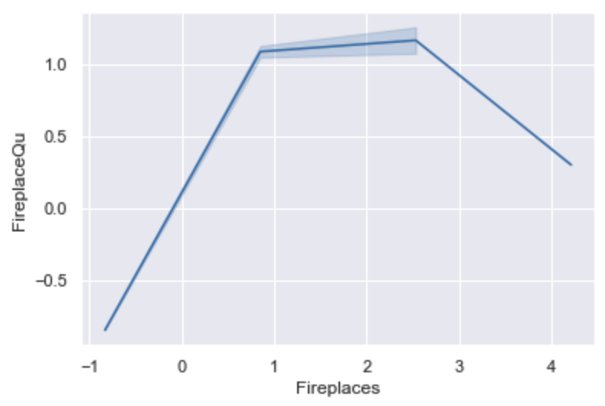
Plots to check if Fireplaces and FireplaceQU are directly proportional
Retaining both variables w/o dropping either for VIF analysis

